Slide 1


Task7: Human Eye
--Course Project of
Natural Language Processing
ZHANG, Chang 2017202134

Slide 2
1
Task and Motivation
2
Related Work and Tools
3
Models
4
Implementation
5
Results and Demo

Slide 3
1
Part
Task and Motivation

Slide 4
Task and Motivation
Task Description
-Conduct and implement the algorithm to generate text knowledge from visual contents.
-The generator should pass Turing-test.
-Similar with task: Image Caption, a classic challenge in the area of Natural Language Processing and Computer Vision.
-The generative model should solve the computer vision challenges of determining which objects are in an image, and it also be capable of capturing and expressing their relationships in a natural language.

Slide 5
2
Part
Related Work and Tools

Slide 6
Background and Reference
·Show, Attend, and Tell: Neural Image Caption Generation with Visual Attention (2016)
·The Attention mechanism in this model allow it to learn where to look. As generating a caption word by word, you can see the model's gaze shifting across the image form the part most relevant to the word to utter next.
·The opensource of author Kelvin Xu’s original implementation can be found on Github: https://github.com/kelvinxu/arctic-captions.

Slide 7

Dataset
· Flickr8
· Include 8,000 images, each with five different caption descriptions that provide clear descriptions of highlighted entities and events. Do not include celebrities or named locations, but manually select multiple scenes and situations.
· Andrej Karpathy's training, validation, and test splits
· Split the whole dataset into training(6000), validation(1000) and test(1000) set. Captions save in json format. [image_id, sentence_id, tokens, raw_sentence]

Slide 8
Tools
· VSCode + Pytorch

Slide 9
3
Part
Models

Slide 10
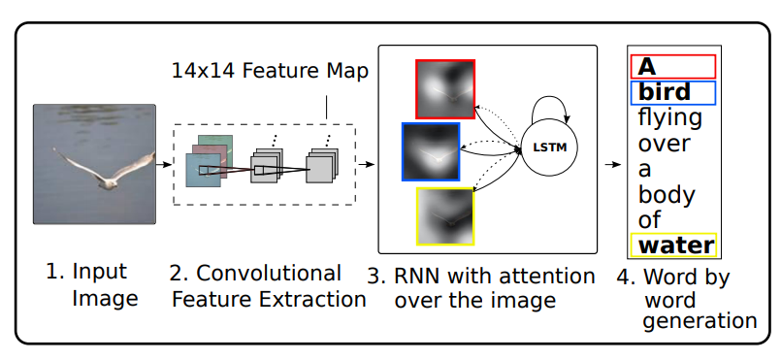
Model Structure

Slide 11
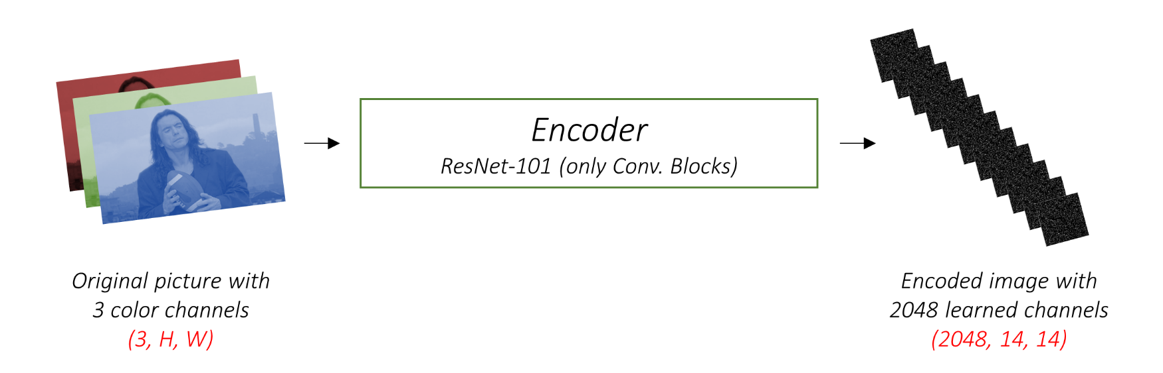
Encoder: Convolutional Feature
·Encode the input image with 3 color channels into a smaller image(14*14) with more learned channels. The author uses Convolutional Neural Networks (CNNs) as the encoder.
·Since the last layer or two of most pretrained CNN models are linear layers coupled with softmax activation for classification, they should be stripped away in this task.

Slide 12
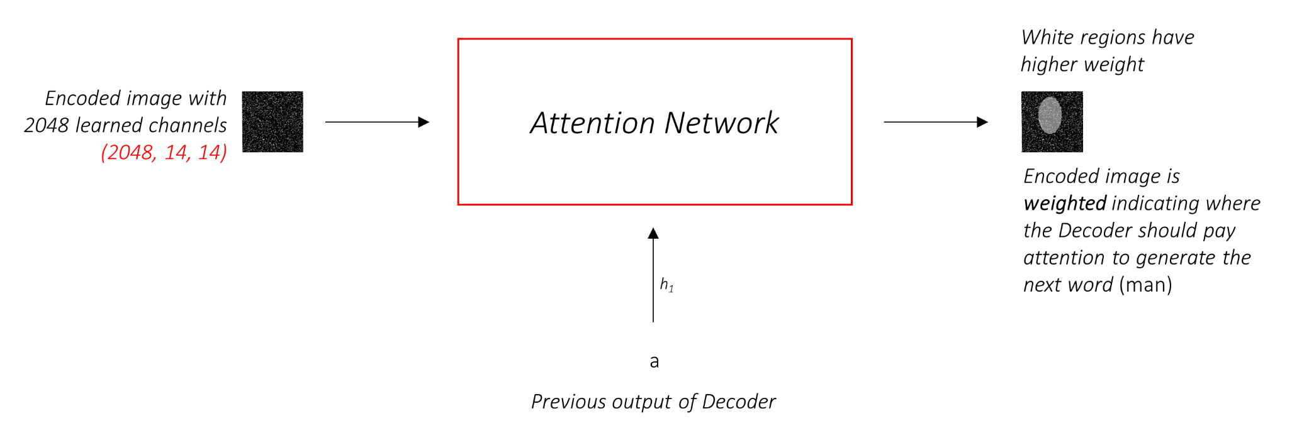
Soft Attention
·Attention considers the sequence generated thus far, and attends to the part of the image that needs describing next. The Attention Network finish the process of computing the probability that a pixel is the place to look to generate the next word.
·soft Attention, where the weights of the pixels add up to 1.

Slide 13
Decoder: long short-term memory (LSTM)
·The Decoder is to look at the encoded image and generate a caption word by word. Since it's generating a sequence, it would need to be a Recurrent Neural Network (RNN) and the author use an LSTM.
·In a setting with Attention, instead of using the simple average of all pixels, the author uses the weighted average across all pixels, with the weights of the important pixels being greater. This weighted representation of the image can be concatenated with the previously generated word at each step to generate the next word.
·A linear layer to transform the Decoder‘s output into a score for each word in the vocabulary. (Beam Search)

Slide 14
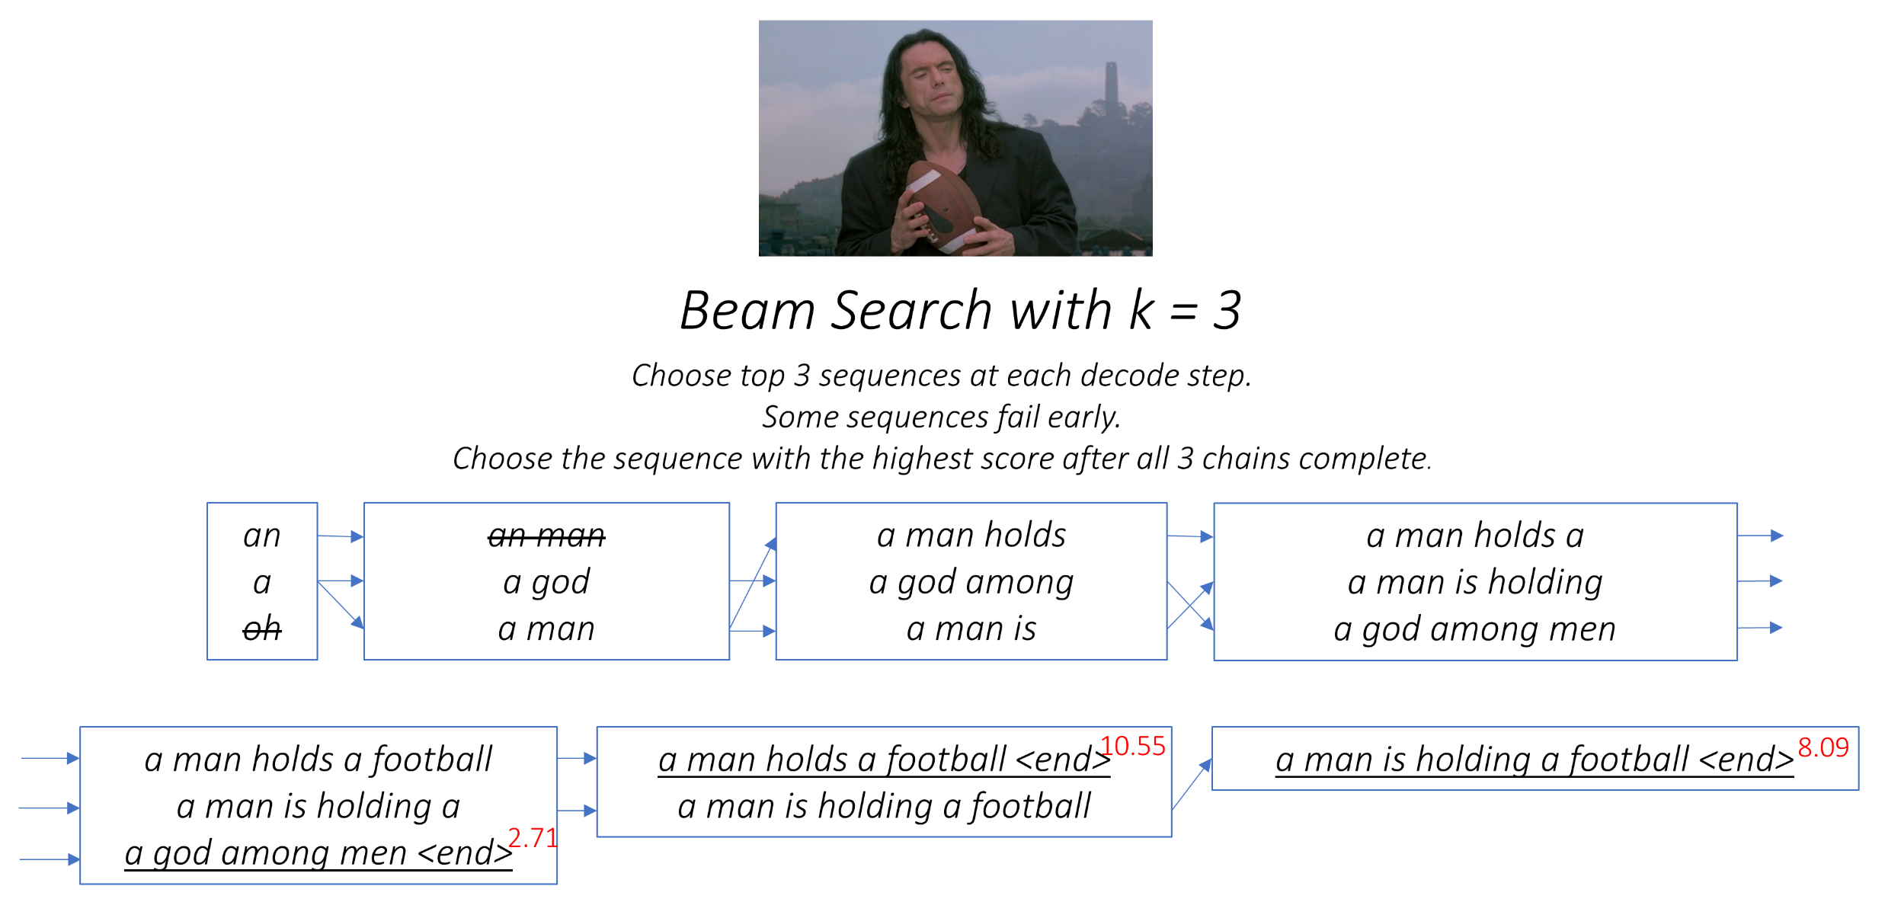
Decoder: long short-term memory (LSTM)

Slide 15
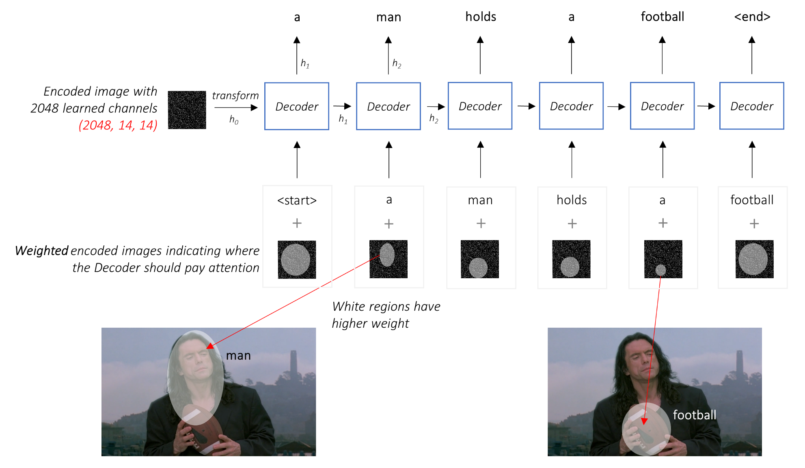
Decoder: long short-term memory (LSTM)

Slide 16
4
Part
Implementation

Slide 17
Inputs
· Three inputs: Images, Captions, Caption lengths
Images
Apply pretrained Resnet-101 from torchvision in CNN part
Images should be resized to 3*256*256, and pixel values must be in the range [0,1] for uniformity.
Images fed to the model must be a Float tensor of dimension N, 3, 256, 256, and must be normalized by the mean (= [0.485, 0.456, 0.406]) and std (= [0.229, 0.224, 0.225]). N is the batch size.

Slide 18
Inputs
Captions
A zeroth word, <start>, to generate the first word. A last word <end> to know when to stop
<pad> tokens, pad the captions in various length and pass the captions around as fixed size Tensors
e.g. <start> a man holds a football <end> <pad> <pad> <pad><end>
A word_map which is an index mapping for each word in the corpus, including the <start>,<end>, and <pad> tokens. To look up embeddings for them or to identify their place in the predicted word scores.
Therefore, captions fed to the model must be an Int tensor of dimension N, L where L is the padded length.

Slide 19
Encoder
· Use a pretrained ResNet-101 already available in PyTorch's torchvision module. Discard the last two layers (pooling and linear layers).
· Add a fine_tune() method to convolutional blocks 2 through 4 in the ResNet to fine-tune the Encoder CNN. Because the first convolutional block would have usually learned something very fundamental to image processing, such as detecting lines, edges, curves, etc.

Slide 20
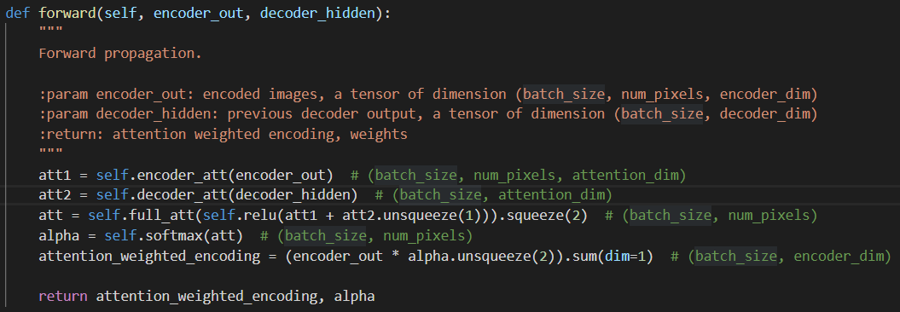
Attention
· Composed of linear layers and a couple of activations.
· Separate linear layers transform both the encoded image (flattened to N, 14 * 14, 2048) and the hidden state (output) from the Decoder to the same dimension. They are then added and ReLU activated. A third linear layer transforms this result to a dimension of 1, and then apply the softmax to generate the weights.

Slide 21
Decoder
·The iteration is performed manually in a for loop (length of input caption_lengths) with a PyTorch LSTMCell instead of iterating automatically without a loop with a PyTorch LSTM. This is because I need to execute the Attention mechanism between each decode step. An LSTMCell is a single timestep operation, whereas an LSTM would iterate over multiple timesteps continously and provide all outputs at once.

Slide 22
5
Part
Results and Demo

Slide 23
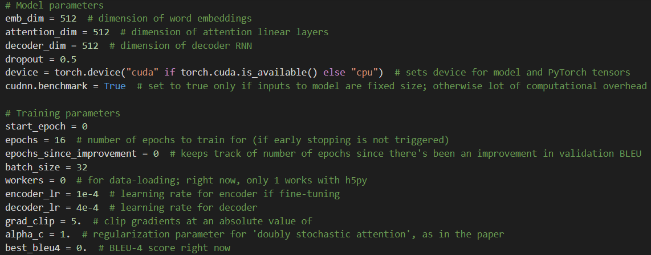
Result
The BLEU-4 score on the test set is 0.2829 out of 1.
(BLEU-4: similarity between reference and hypothesis text)

Slide 24
Demo

Slide 25

Thanks for listening

